Slide 1
Leveraging the Microsoft Graph API from the SharePoint Framework
Extending SharePoint with information from the Microsoft Graph

Slide 2

Microsoft Graph and SPFx
Intro to the Microsoft Graph
Granting SharePoint Online Tenants scopes to access Microsoft Graph Resources
SPFx’s MSGraphClient
Microsoft Graph TypeScript type declarations
Resources

Slide 3
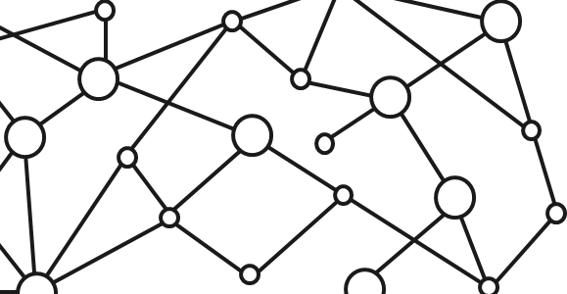
Microsoft 365 Platform
Extend Microsoft 365 experiences
web, device, and service apps
Build your experience
Documents
Pages
Conversations
Timeline
iOS/Android/Windows/Web
1
Microsoft Graph
Notes:
Our Office 365 developer vision focuses on the Users’ experience and their data. As a developer you can bring your applications into their user experience. With over 1.2+ billion users of Office Worldwide, this is a huge opportunity to provide a window into your applications. As well as being able to connect into their data and add intelligence to your applications. There are currently 850 million events created a month and a total of 470Pb+ of data stored in the service that can add value to for our Users’.

Slide 4
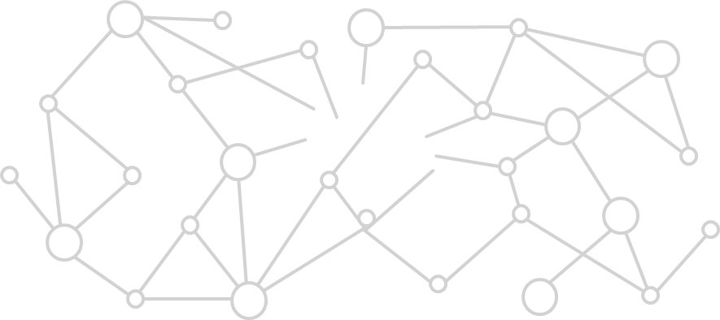
Microsoft Graph Gateway to your data in the Microsoft-cloud
https://graph.microsoft.com
Office 365
Windows 10
Enterprise Mobility + Security
Users, Groups, Organizations
Outlook
SharePoint
OneDrive
Teams
Planner
Excel
OneNote
Activities
Device Relay
Commands
Notifications
Azure AD
Intune
Identity Manager
Advanced Threat Analytics
Advanced Threat Protection
Mail, Calendar,
Contacts and Tasks
Sites and Lists
Drives and Files
Channels, Messages
Tasks and Plans
Spreadsheets
Notes, and more…
Identity Management
Access Control
Synchronization
Domains
Administrative Units
Applications and Devices
Advanced Threat Analytics
Advanced Threat Protection
Alerts
Policies
and more…

Slide 5
Microsoft Graph, gateway to Office 365
Single resource that proxies multiple Microsoft services
Allows for easy traversal of objects and relationships
Simplifies token acquisition and management
Eliminates the need to traditional discovery (using “me” and “myorganization”)

Slide 6
Azure AD Applications: The Microsoft Graph Dependency
All Microsoft Graph access options (REST API / SDKs) depend on Azure AD
Must register an Azure AD application to access the Microsoft Graph
Use the Azure AD application to authenticate, gain authorization & obtain an access token
Access token included in the underlying HTTP request to call the Microsoft Graph endpoint

Slide 7
Calling Secured Services from Client-side Code is a Challenge
Calling a secured service, like Microsoft Graph, requires the acquisition of a token
Authenticate and get authorized with Azure AD using an Azure AD application
Interactive login & programmatic acquisition of access token
Client-side applications cannot securely do this across domains seamlessly
Can’t store application ID’s and secrets client side as they cannot be protected
Require an authentication prompt with a popup or redirection

Slide 8
Solution: Proxy Calls to Secured Services through Existing Application
SharePoint Online already has an Azure AD application
Client-side solutions in SharePoint Online call the SharePoint REST API in the same domain
No extra authentication required
Provided these tenants have granted the necessary scopes, SharePoint will call the Microsoft Graph
Responses from the Microsoft Graph are returned back to the client-side application
Permission requests to Azure AD applications (aka: resources) must be approved
Only SharePoint Online tenant administrators can grant / reject permission requests
Approved permissions are available to all client-side solutions in a tenant

Slide 9
SPFx Solutions Declare Permission Requests
// package-solution.json
{
"$schema": "https://developer.microsoft.com/json-schemas/spfx-build/package-solution.schema.json",
"solution": {
"name": "ms-graph-sp-fx-client-side-solution",
"id": "dfb230b7-4f61-431f-9b65-a34e83922663",
"version": "1.0.0.0",
"includeClientSideAssets": true,
"webApiPermissionRequests": [
{ "resource": "Microsoft Graph", "scope": "User.ReadBasic.All” },
{ "resource": "Microsoft Graph", "scope": "Calendars.Read” },
{ "resource": "Microsoft Graph", "scope": "Tasks.Read” }
]
},
"paths": {
"zippedPackage": "solution/ms-graph-sp-fx.sppkg"
}
}

Slide 10
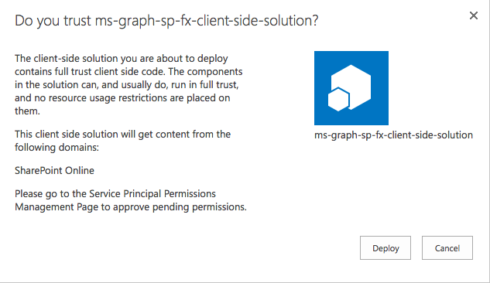
Add SharePoint Package to SharePoint App Catalog
Upload SharePoint packages to the app catalog
Extra note in dialog notifies of additional step required
While application can be installed in SharePoint sites, it does not have the permissions granted that it needs to access Azure AD protected resources

Slide 11
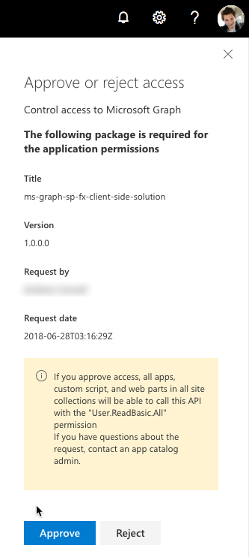
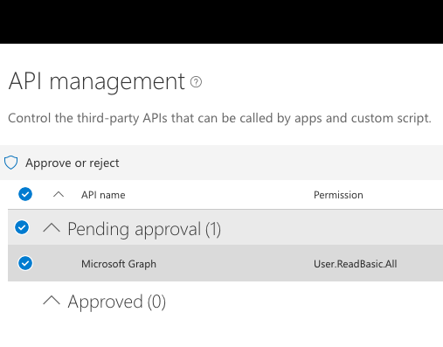
Approve / Reject with SharePoint Online API Management Page

Slide 12
SharePoint Framework Includes a Microsoft Graph Client
MSGraphClient: SharePoint Framework’s Microsoft Graph Client
Abstracts the token acquisition from the SharePoint Framework’s support for Azure AD
Wraps the Microsoft Graph JavaScript SDK and initializes it with one line that returns a promise
this.context.msGraphClientFactory
.getClient()
.then((client: MSGraphClient): void => {
// use MSGraphClient here
});

Slide 13
Microsoft Graph TypeScript Type Declarations
import * as MicrosoftGraph from '@microsoft/microsoft-graph-types';
// init Microsoft Graph client
client
.api('/me')
.get((error: any, user: MicrosoftGraph.User, rawResponse?: any) => {
console.log('name: ', user.displayName);
console.log('email: ', user.displmailayName);
console.log('phone: ', user.businessPhones[0]);
});
});

Slide 14
Demo Accessing User Details from the Microsoft Graph in a SharePoint Framework Client-Side Web Part

Slide 15
Reading further
Microsoft Graph
https://developer.microsoft.com/graph
Graph Explorer
https://developer.microsoft.com/graph/graph-explorer
Microsoft Graph JavaScript SDK
https://github.com/microsoftgraph/msgraph-sdk-javascript
SharePoint Framework Documentation
https://docs.microsoft.com/sharepoint/dev/spfx/sharepoint-framework-overview
Use the MSGraphClient to Connect to Microsoft Graph
https://docs.microsoft.com/sharepoint/dev/spfx/use-msgraph

Slide 16
Thank you.

